Slide 1

ATTIRE LENS
RCEL 506 - Applied Statistics &
Data science for Engineering Leaders
SANJANA KUMAR

Slide 2

Table of Content
Introduction
Problem Statement Metadata
Data Preprocessing
Features
Feature extraction
Results
Text Classification
Results
Future Work
Literature review
EDA
Machine Learning Model
Recommendation Using Image Similarity Search

Slide 3
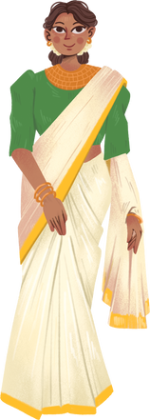
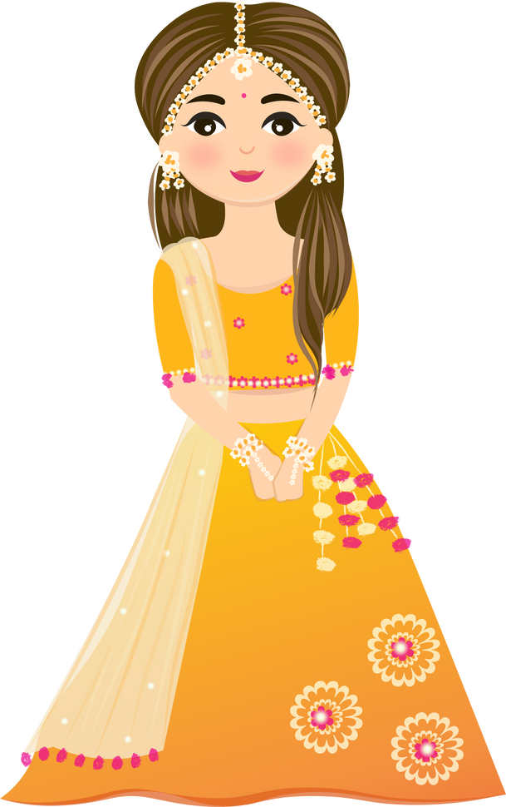

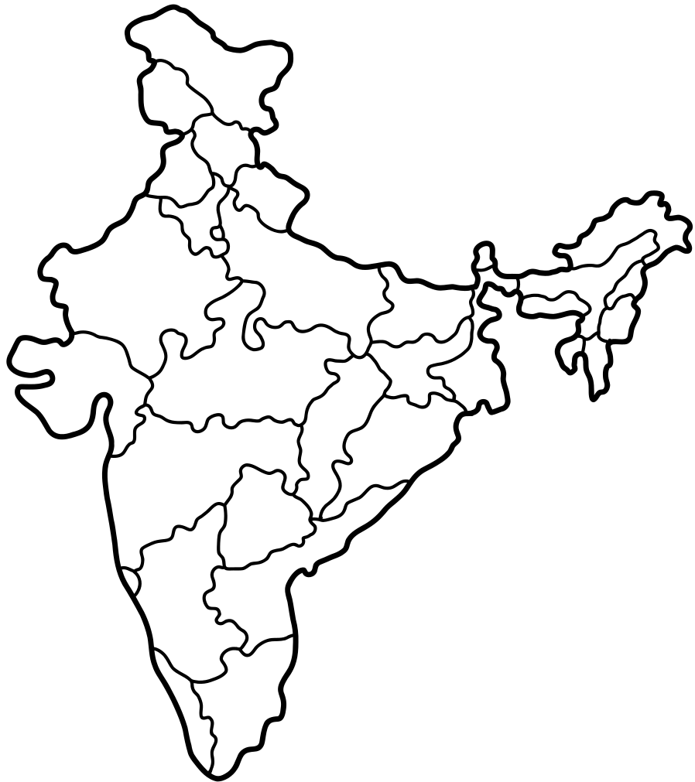
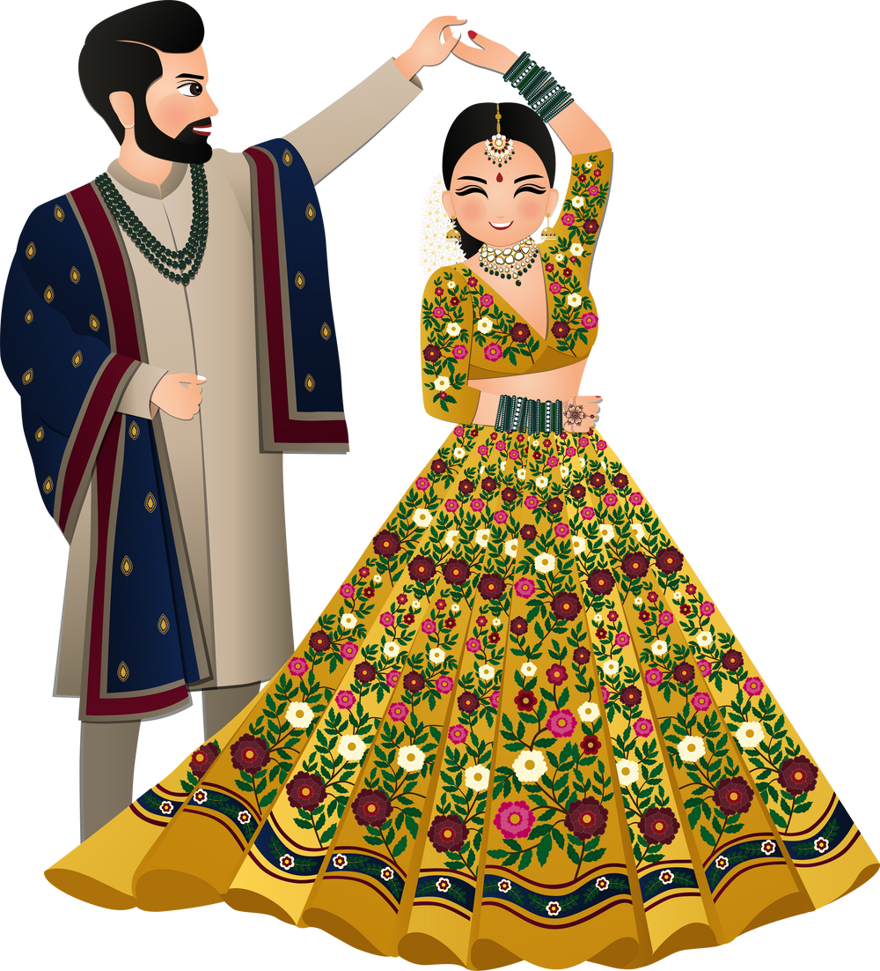
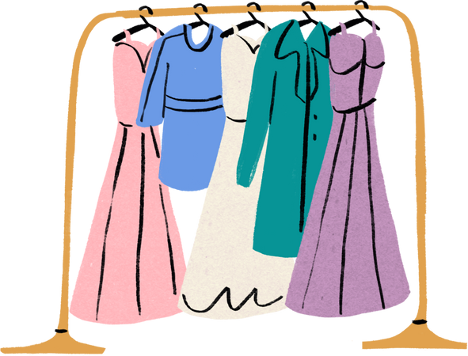
Introduction
Indian online
shopping platform
Indian online
shopping platform
Fashion
Fashion
Indian Attire
India
Indian Attire
India
WWW.REALLYGREATSITE.COM

Slide 4
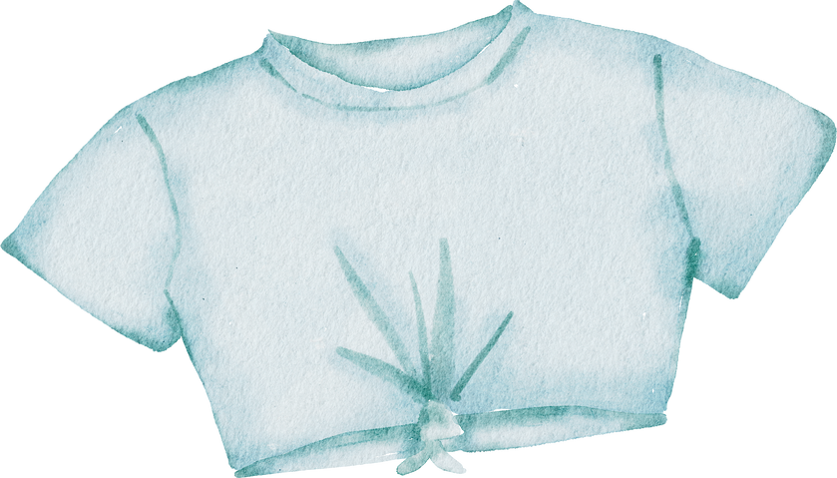

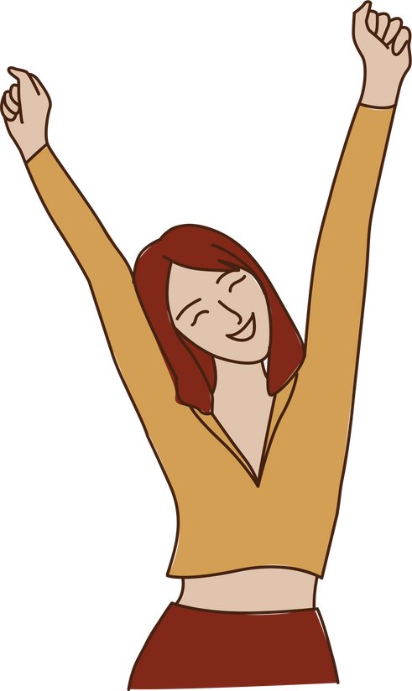



Introduction
Recommend similar options
Crop Top
Attire lens
Saw some attire and loved it
Desire to have a similar
crop top
Upload an image
HAPPY

Slide 5
Problem Statement
Firstly, to study the dataset and explore various plots from the available dataset
Create a model that helps you find similar clothing products in an Indian online shopping website which takes image input as well as text input.

Slide 6



Metadata
16K VIEWS
Year: 2022
2049 Downloads
Fashion Dataset.csv
14.5K Entries
11 columns
3 GB

Slide 7

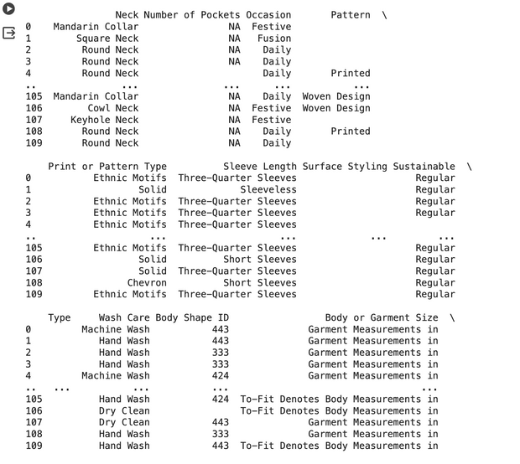
Data Pre-processing
List comprehension
Column Extraction
Filtering

Slide 8
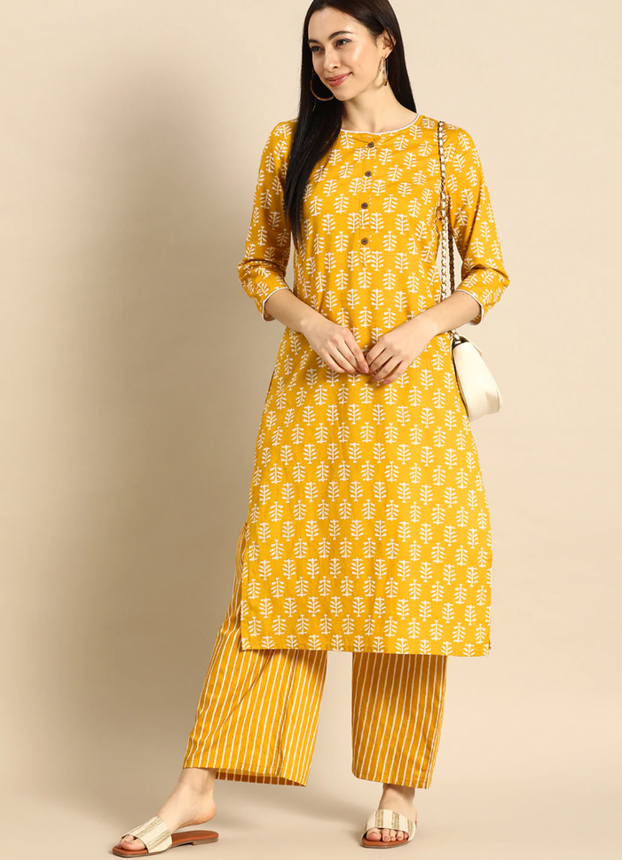
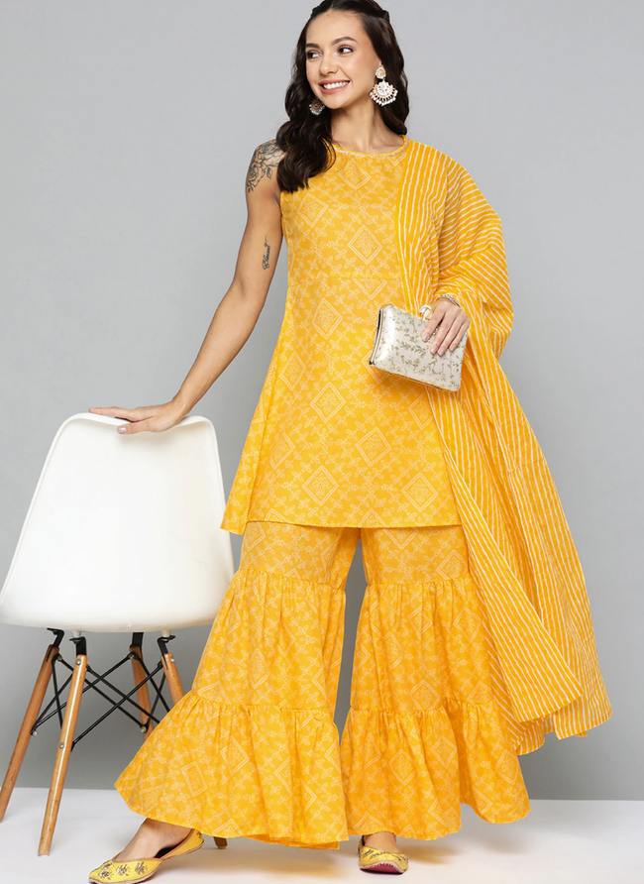


Features
Kurta
Kurta
Dupatta
Yellow
Palazzo
Sharara
Yellow

Slide 9
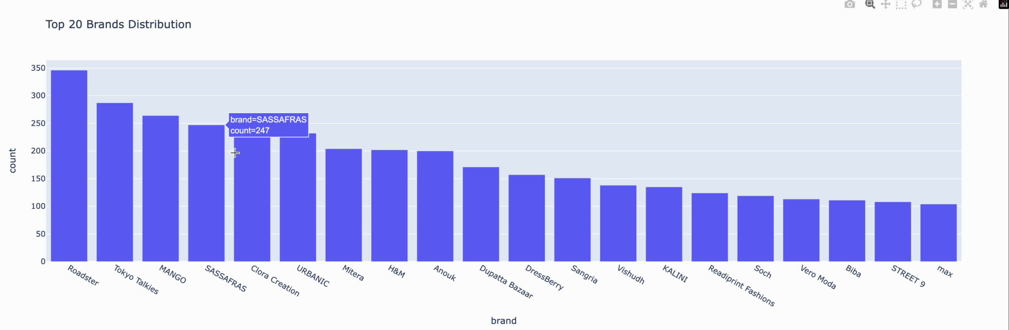
EDA

Slide 10
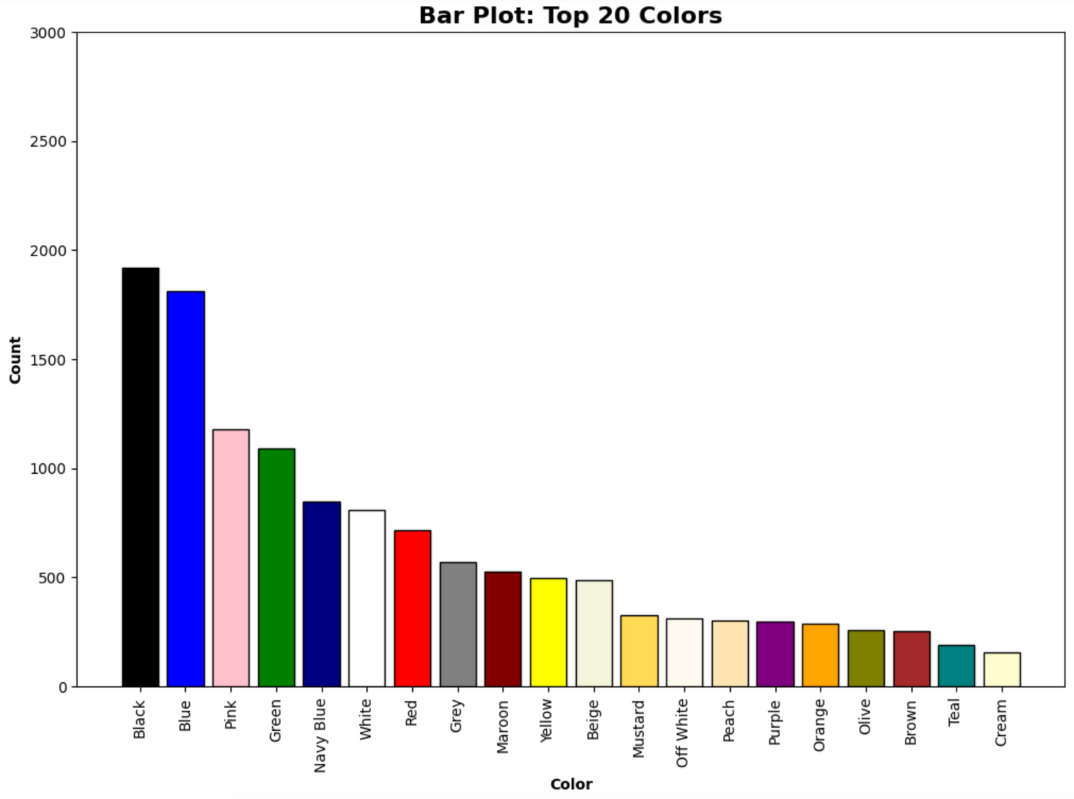

Slide 11
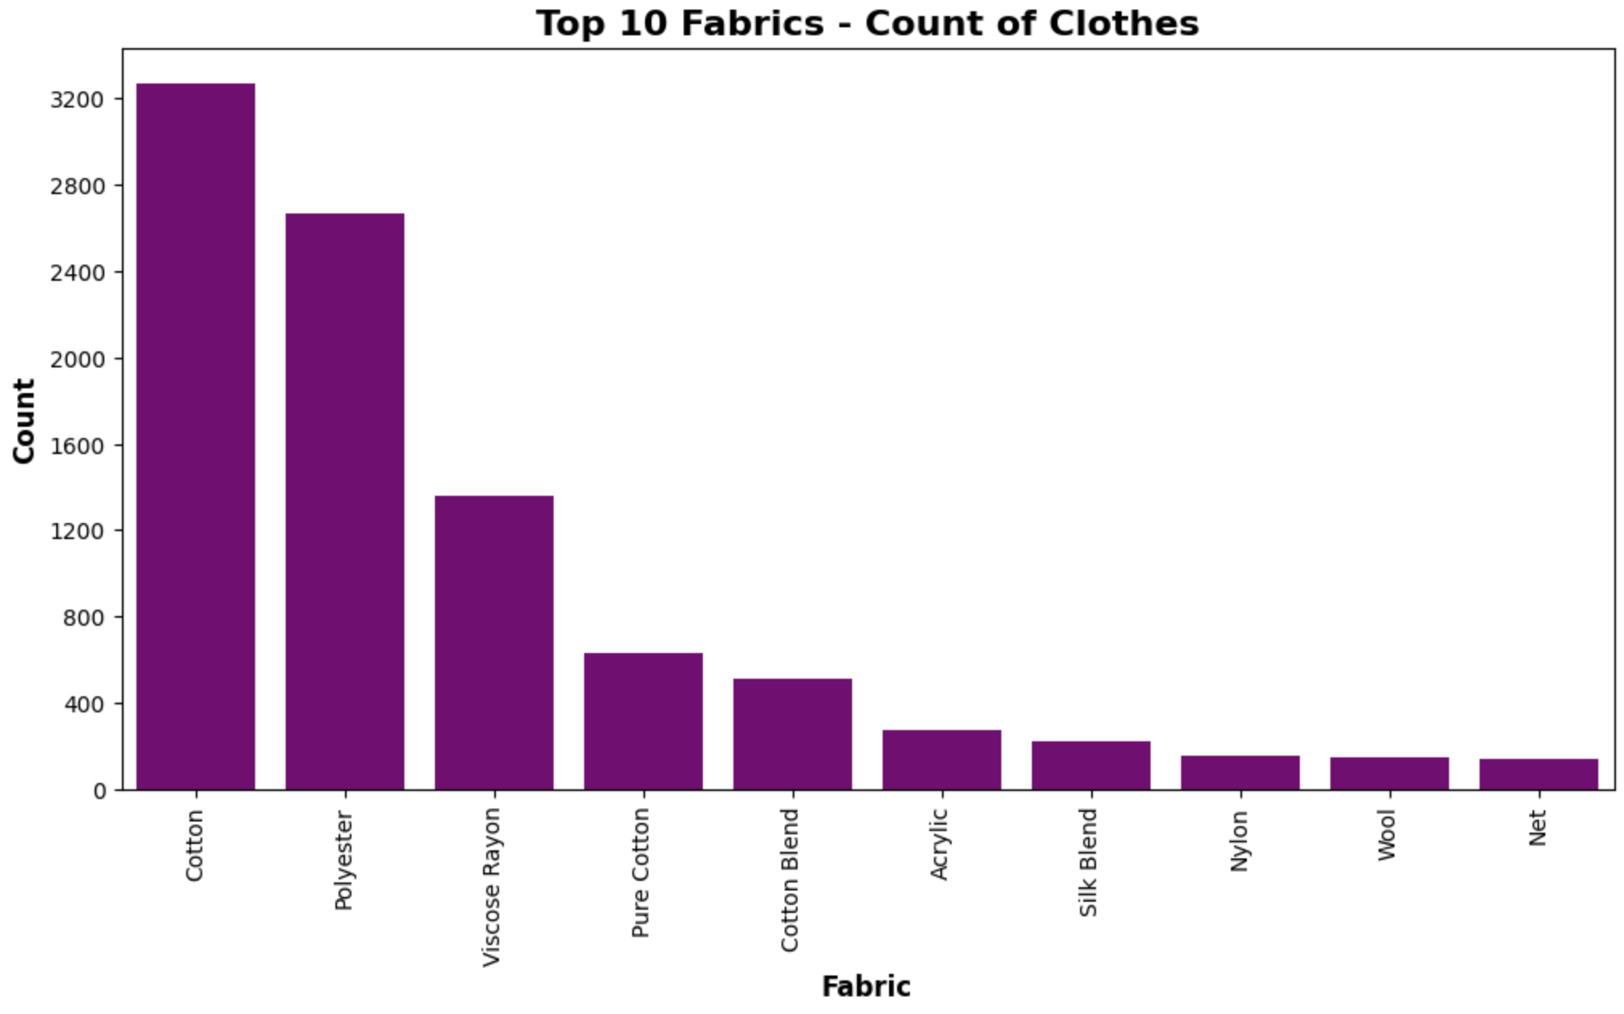

Slide 12
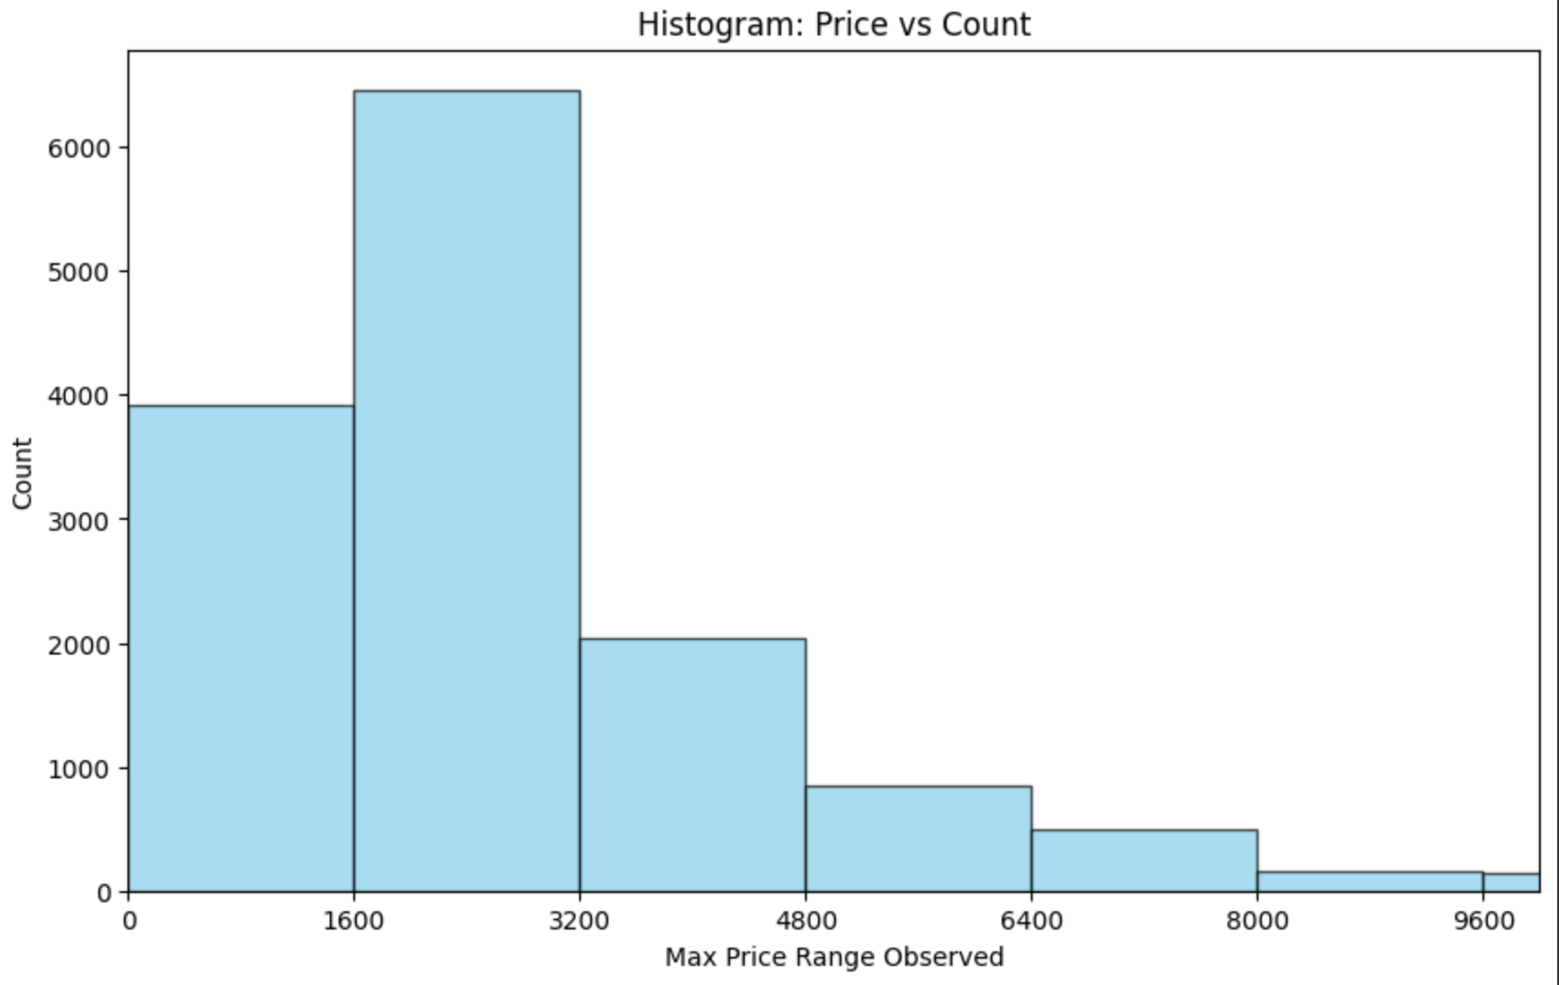

Slide 13
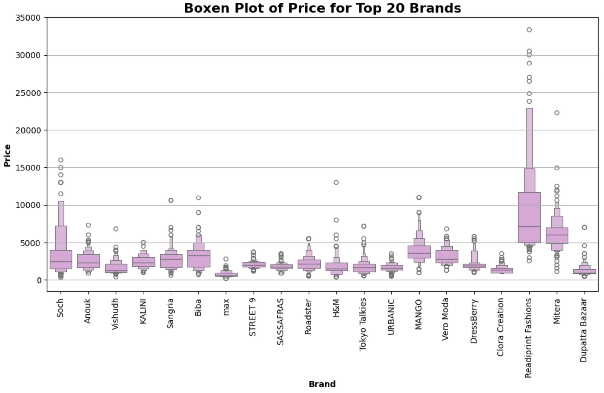

Slide 14
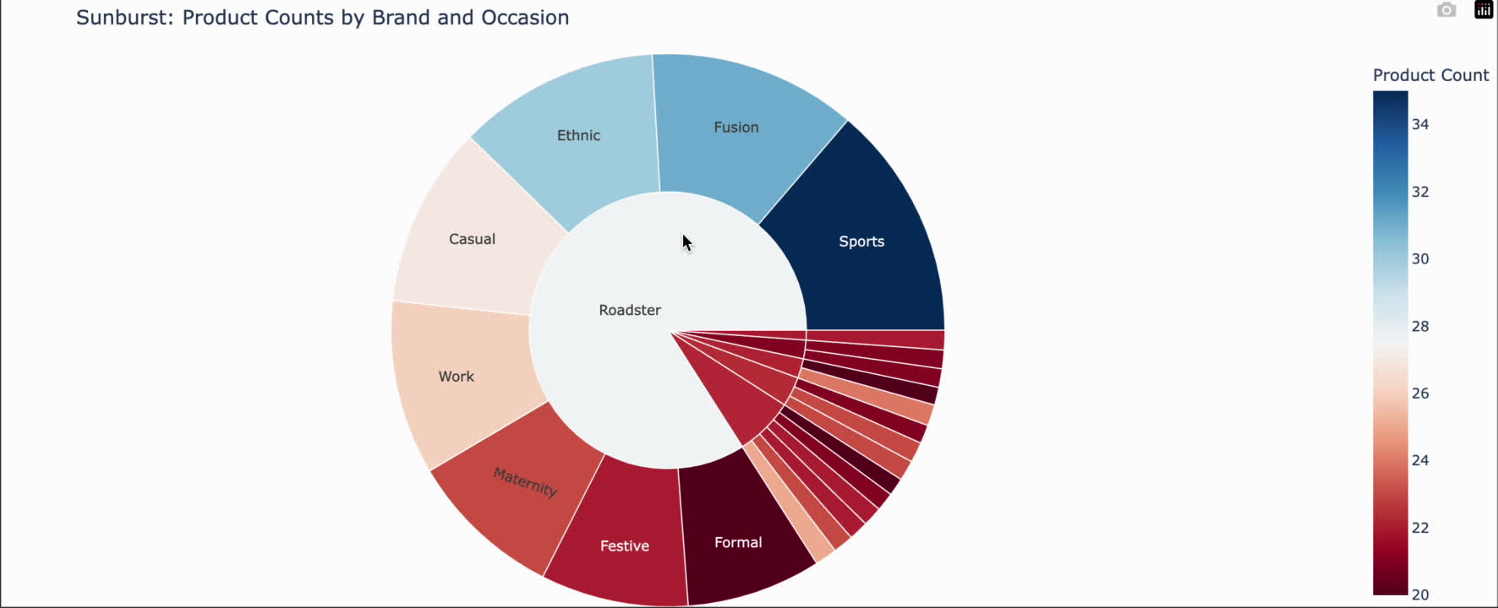

Slide 15
Machine Learning Model
14.5K Images
Reduced dataset
Filtered the data again
Color occurances less than 600
8.5K Images
52 colours

Slide 16
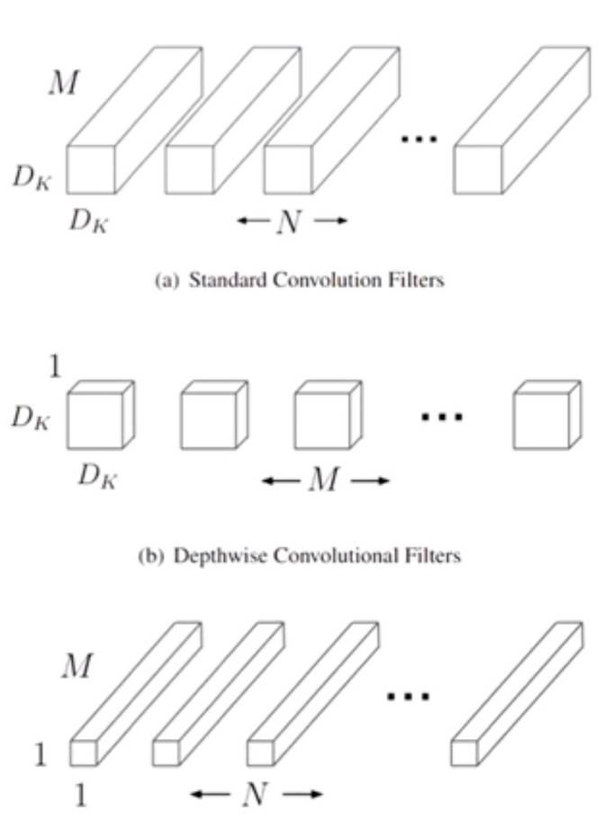
Recommendation using Image Similarity Search
Module: Tensorflow Keras for image pre-processing
Model : MobileNet for Feature extraction
Cosine similarity for Image similarity

Slide 17
Feature extraction
Edges, corners, and textures
Loading and preprocessing
Abstract patterns and shapes
Categories, object parts, or scene attributes
spatial information across the
entire image
Extracted features loaded in a list
With corresponding image paths
Calculates cosine similarity between the query image and all other images.
5 similar images output

Slide 18
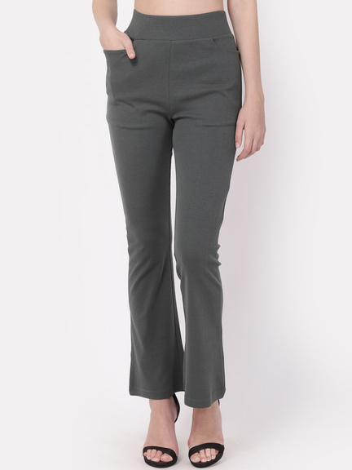
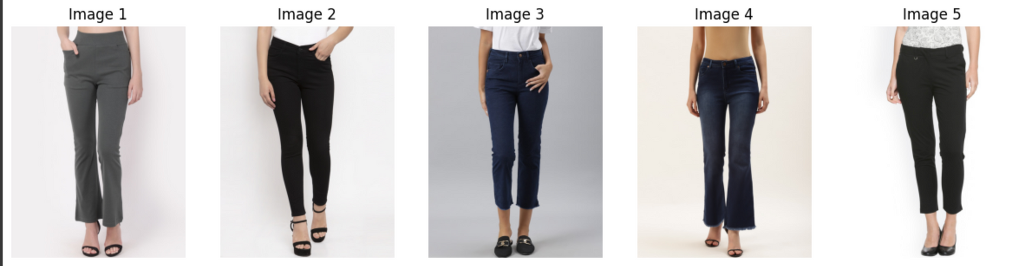
Results
Input image
Recommendations

Slide 19
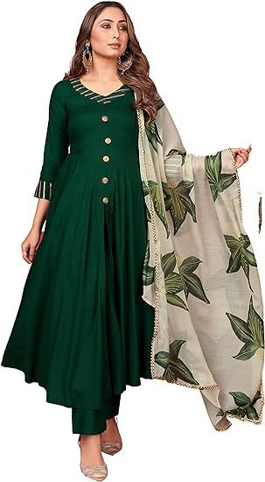
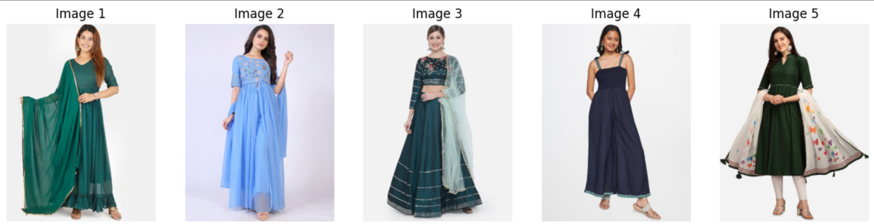
Input image

Slide 20
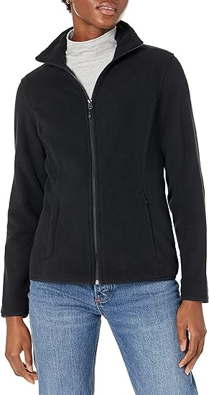
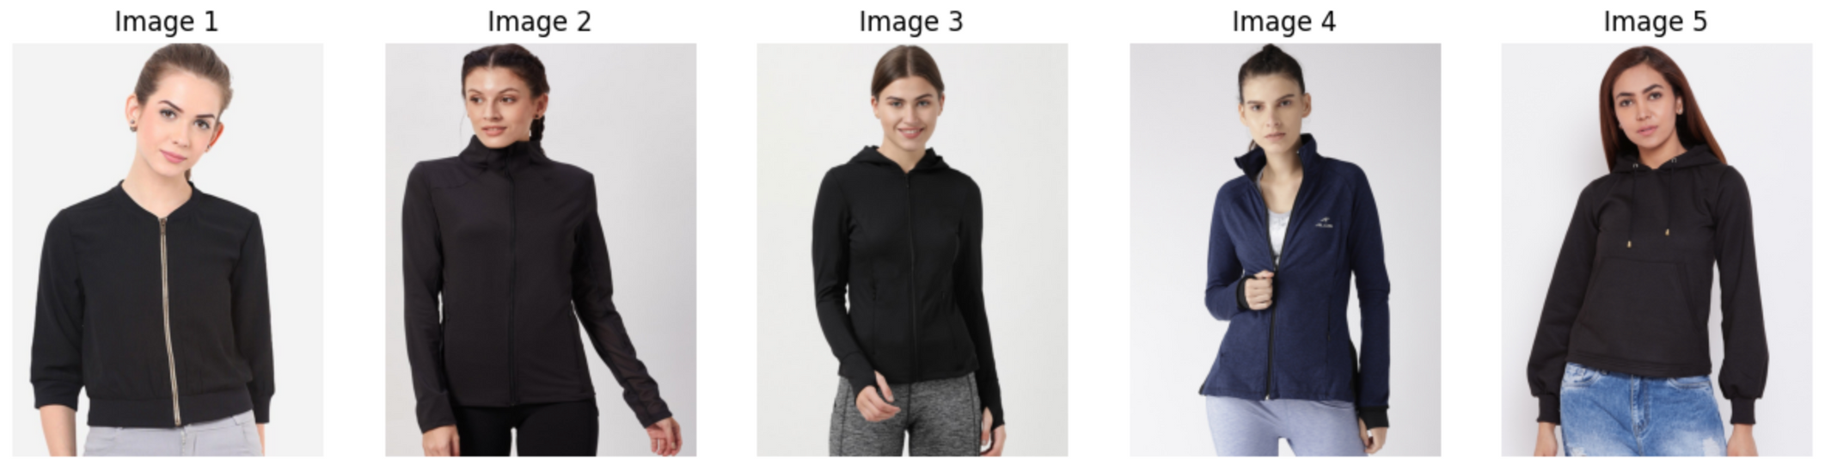
Input image

Slide 21
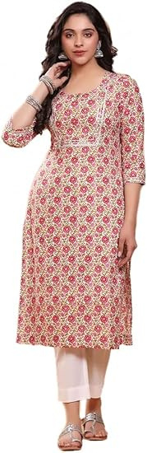
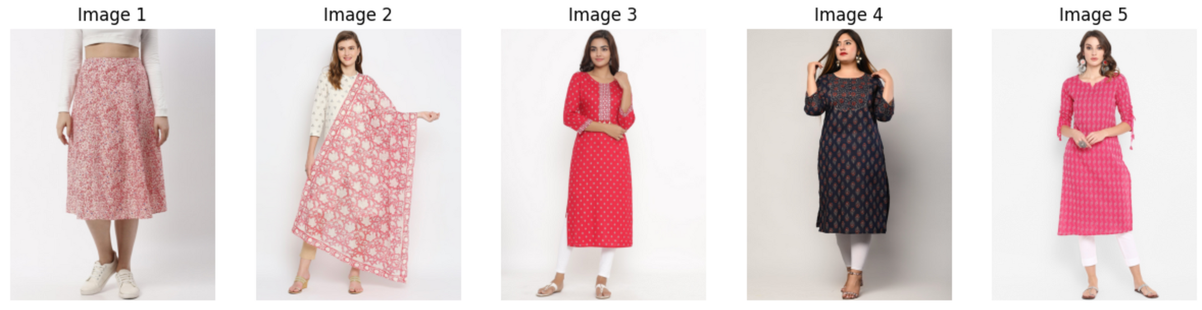
Input image

Slide 22
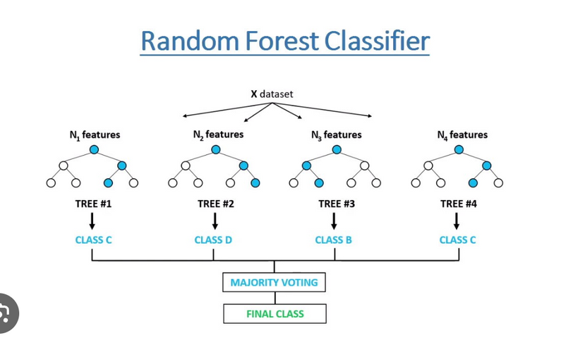

Recommendation using Text classification
Module: Ensemble from sklearn
Model : RandomForestClassifier
TFID Vectorization technique
TF(t,d) = Total number of terms in document d
Number of times term t appears in document d
​
IDF(t,D)=log Total number of documents in the corpus ∣D∣
1+Number of documents containing term t
TF-IDF(t,d,D)=TF(t,d)×IDF(t,D)

Slide 23
Working
Text preprocessing
Building Combined Text Column
Feature Extraction using TFIDF
Target variable: Color
Model
Output

Slide 24
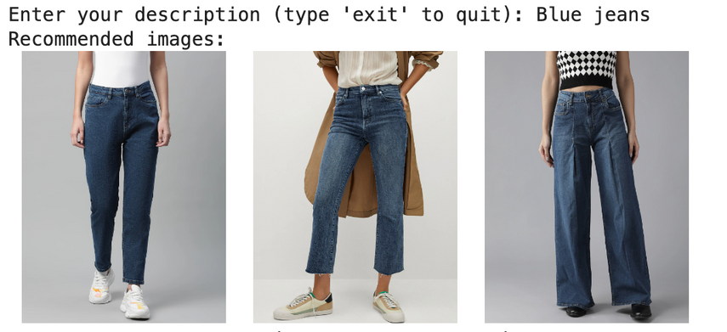
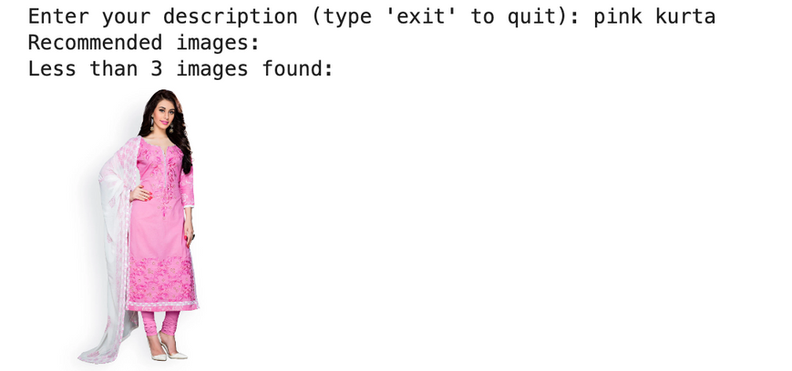
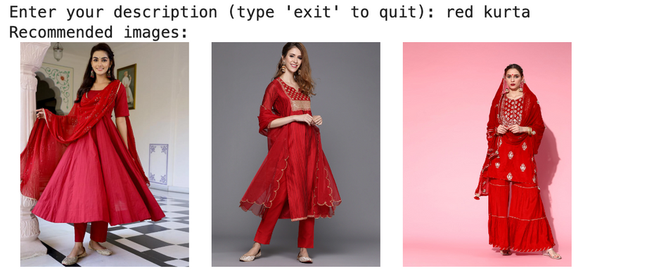
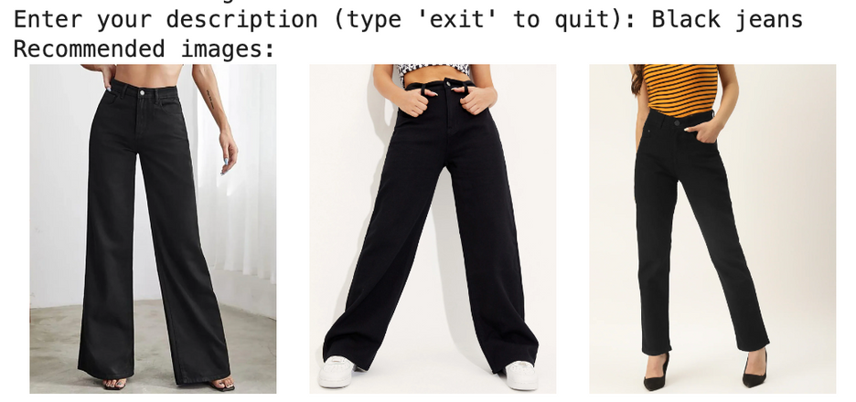
Results

Slide 25
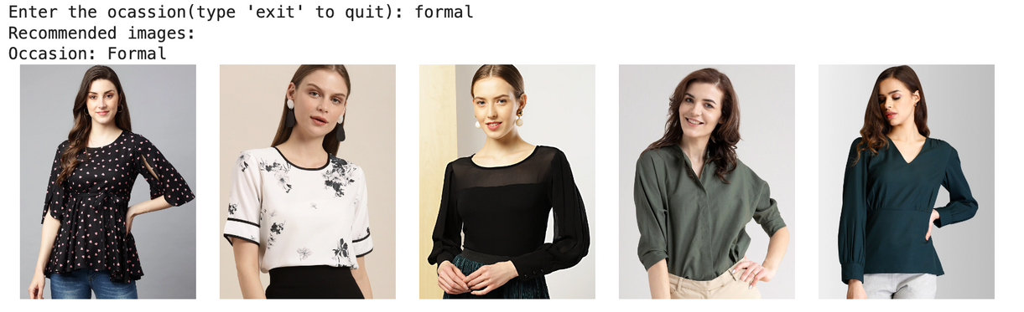
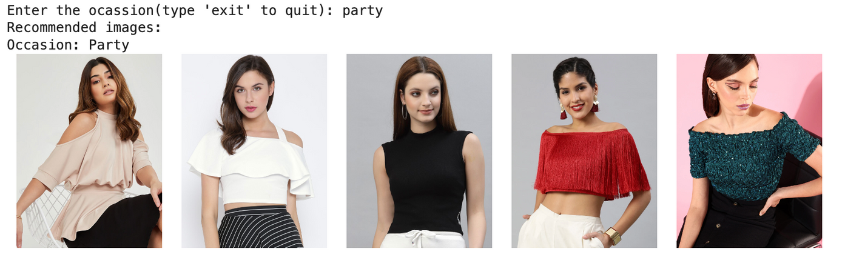
Results

Slide 26
Confusion Matrix-Heatmap

Slide 27
Classification report
Precision
Recall
F1-Score
Support
-
-
Accuracy
0.76
2862
Macro_avg
0.46
0.49
2862
0.60
Weighted average
0.76
0.76
0.75
2862

Slide 28
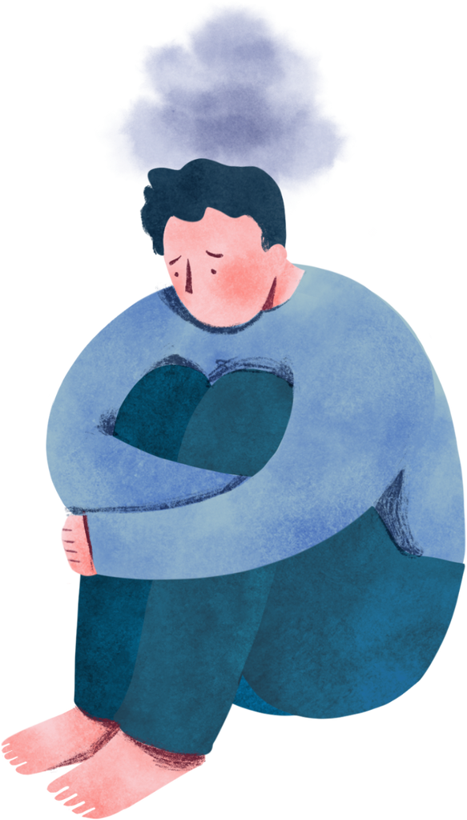
Ethics
May contribute to unrealistic beauty standards and negative body image perceptions.

Slide 29



Future Work
Indicate Sustainability factor
Enhance the model accuracy
Create a user interface

Slide 30



Literature Review
Available Datasets: Kaggle, Github, Data world
Why Kaggle Myntra Dataset: It had the attributes that mostly matched my problem statement
An approach for recommending similar fashion products:
https://arxiv.org/pdf/2008.11638
Fashion Recommendation System, Models and Methods:
https://www.mdpi.com/2227-9709/8/3/49
An intelligent personalized Fashion recommendation system:
https://ieeexplore.ieee.org/document/5581949
Fashion Recommendation System:
https://www.jetir.org/papers/JETIR2305C92.pdf
Personalized fashion recommendation system with image based neural networks:
https://iopscience.iop.org/article/10.1088/1757-899X/981/2/022073/pdf

Slide 31
References

Slide 32

Thank
You!

